Slide 2
A joint project
Funds from PNRR
FOSSR (Fostering Open Science in Social Science Research), coord. Giulia Missikoff Andrighetto (Istituto di Scienze e Tecnologie della Cognizione, CNR)
+
e-Mago – Spoke 2 of the GRINS Extended Partnership

Slide 3
e-Mago in a nutshell
A platform that enables the networking of laboratories conducting behavioral experimental research across Italy.
The primary goal of this platform is to connect researchers with participants, providing them with
- access to a rapid, reliable, and large-scale data collection
- disseminate behavioral interventions for experimental validation
- within a broad base of volunteers recruited nationwide.

Slide 4
Front-end: a three-sided web-app
Participants: 18+ with an Italian taxpayer code
- register and release privacy consent
- regularly update their sociodemographic info
- receive invitations
- register for studies
- receive reminders
- accumulate “points”
- convert “points” to vouchers (or cash)

Slide 5
Front-end: a three-sided web-app
Researchers: any department in Italy can join
- create their “studies”
- screen participants based on socio-demographics and previous experiences
- invite participants and monitor recruitment
- record participants’ activity
- attribute credits to participants, to reward their activity
- download summary information on their studies
- see the calendar of all activities already planned by others
- researchers do not have access to participants’ identity
Note: on-line studies will not be run through e-Mago: participants will receive a link to any platform of your choice (Qualtrics, oTree, etc…)

Slide 6
Front-end: a three-sided web-app
Administrators
- have access to participants’ identity, for administrative reasons
- manage researchers’ requests and bills
- update and maintain the platform
- manage the subject pool
- are responsible for data protection

Slide 7
Back-end: structure of the platform
Participants
Researchers
Administrators
Identity and privacy
Studies
Laboratories:
Local labs
On-line
Surveys
Socio-demographics
Payments
Sub-pools:
Standard
Panel
(Deceived?)
Credits
Billing
&
Payments

Slide 8
Different types of studies
Standard laboratory experiments – need to choose the local lab(s)
Use the platform to recruit participants and invite them to go to the lab
On-line studies & surveys (or survey experiments)
Recruit participants and distribute the links
Panel studies
Link the data of your own experiments with longitudinal data on the participants in the panel
Use the panel data to select specific categories of participants
E.g.: only those who got married/had children/graduated/retired… in the last 12 months.

Slide 9
The panel
After having established a large pool of potential participants
Select among them a sub-pool that is as representative as possible of the population (geographically and socio-demographically)
Invite them to be part of a “special” pool: rotating panel
Participants in the panel:
Must fill in a general questionnaire every year (January?)
Receive a fixed compensation for this
Cannot be recruited for “standard” studies

Slide 10
Preserving anonymity
Every participant is identified by a unique ID
Recruiting researchers receive only the list of participants’ IDs
For on-site studies, researchers can ask for identity on site (for payment)
For on-line studies, participants enter with their unique ID.
If payment is done through the platform: no need of asking individual ID.

Slide 11
Linking data across studies
Participants’ unique ID
Can be linked with their answers in the experiments/surveys
Can never be linked to participants identity
Can thus be used to link data from different studies
Conducted by the same group of researchers at different times
Conducted by different groups of researchers who agree to share this information

Slide 12
Recruitment
Joining laboratories can invite their subject pools to migrate on e-Mago
A nation-wide recruitment campaign

Slide 13
(Tentative) timeline
30-09-24: prototype
31-12-24: platform ready for implementation: Bologna+CNR
During 2025:
onboarding of other laboratories
Nation-wide recruitment
01-01-26: open the platform to all departments

Slide 14
e-Mago and GRINS in the long run
Sustainability:
Departments can join by paying an annual flat fee
Exploitability:
Single researchers can access the platform by paying a piece-rate fee
e-Mago and Amelia:

Slide 15
Dreams

Slide 16
Payments: participants' side
Participants cumulate credits associated to their account
From studies conducted by different researchers, at different times
Through the platform, they
can convert these credits into cash (e.g. via PayPal)
or vouchers (possibility to choose among different providers).
They can also decide to devolve their credits to charities.

Slide 17
Payments: researchers' side
Researchers can
keep on using their own payment procedures
Use the platform for payments
If they use the platform to pay subjects
They attribute credits to participants to their studies
Transfer to the platform the corresponding amount of money
The money will be then distributed to participants, at the time and in the form chosen by the participants themselves.

Slide 18
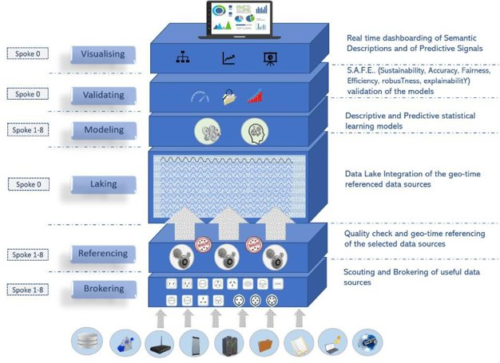
Link with administrative data? Amelia

