Slide 1
Assessing Health System Resilience
28 novembre 2023
Milena Vainieri
Laboratorio Management e sanita’ – Institute of management, Scuola Superiore Sant’Anna di Pisa

Slide 2
A brief premise

Slide 3
A premise
The scope of our analyses is to build up a set of measures to understand the factors influencing health system resilience
Large experience in measuring performance in healthcare services (20y)
Performance measurement systems in the pandemic era. From dashboards to Health System Performance Assessment (HSPA):
E Barbazza, D Ivanković, K Davtyan, M Poldrugovac, Z Yelgezekova,….The experiences of 33 national COVID-19 dashboard teams during the first year of the pandemic in the World Health Organization European Region: A qualitative study. Digital health 8, 20552076221121154
Vola F, Benedetto V, Vainieri M, Nuti S. (2022) The Italian interregional performance evaluation system. Research in Health Services & Regions
Vainieri M., Vola F. (2023) The challenges of measuring performance in pandemic times. Evidence from Italy. In Niccolò Persiani, I.E.Vannini, A. Romiti, A. Karasavvoglou, P. Polychronidou Healthcare Systems’ Challenges in the Era of Covid-19. Springer

Slide 4
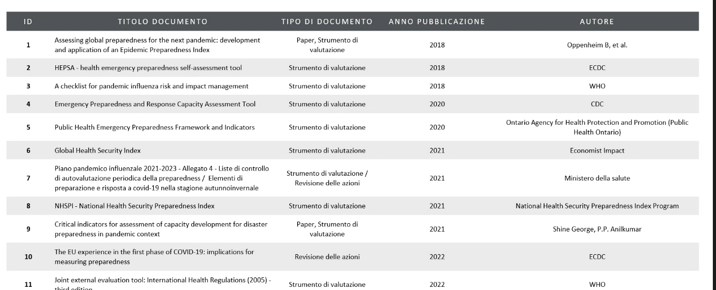
A premise

Slide 5
What we are finalizing as first step

Slide 6
What we did? – A collection of empirical case studies on resilience in HSPA
Presented at the IRSPM conference
Submitted to a WHO Bulletin special issue
Team: Milena Vainieri, Alessia Caputo & Alessandro Vinci

Slide 7
What we did? – A collection of empirical case studies on resilience in HSPA
A collection of empirical evidence to understand how European countries have measured resilience in their HSPAs
The case study selection process was limited to European Union (EU) for the following reasons:
the European Union has played a central role in supporting and endorsing HSPA initiatives since 2014, setting up the Expert Group on HSPA fostering a shared understanding of HSPA approaches by exchanging insights from national experiences;
the Country Health Profiles (EU) contain various performance metrics, including health status, health system governance, accessibility, and resilience. Thus, there is already a supranational organization providing a guide in including resilience in HSPA even before the COVID-19.
the European Commission underscored the significance of resilience in its 2014 report "Communication on effective, accessible, and resilient health systems“ just after the Ebola outbreak

Slide 8
What we did? - A collection of empirical case studies on resilience in HSPA
We conducted a literature review integrated by the HSPA support program from EU.
A total of 845 documents were retrieved with the review of the literature between 2014-2023.
Exclusion criteria: no centred on a single national healthcare system or comparison of them. Focused on a single aspect instead of embracing a comprehensive system-wide perspective.
Overall we identified 9 countries in EU with HSPA description. We conducted a qualitative analysis to classify the written materials collected (the national HSPAs) based on identified categories of similar patterns. We applied a content analysis to the HSPA collected throughout the literature review process.

Slide 9
What we did? - A collection of empirical case studies on resilience in HSPA
No resilience
No documents
No resilience

Slide 10
What we did? – Resilience measured as...
Potential unmet needs and lower outcomes. (Italy & Belgium)
maintain essential health services and quickly resume to optimal performance
new invasive cancer cases.
The capacity to protect vulnerable groups. (Italy, Belgium, Estonia, Czechia)
vaccination coverage.
incidence rates of vaccine-preventable diseases per 100,000 population, provide mental health services
The management’s capacity to acquire and use resources (Belgium, Croatia, Ireland, Czechia)
generic pharmaceutical usage,
public health and long-term care expenses,
bed occupancy rates
average waiting time between test and results,
surge capacity
investments and reforms should be considered in the context of technological and infrastructure capabilities.

Slide 11
What we did? – Resilience measured as...
the capacity to have staff prepared (Czechia, Belgium, Ireland, Croatia).
the number of medical doctors and nurses on beds
the well-being of healthcare professionals. psychological state of healthcare workers.
Intention to leave and absenteeism questions are used to measure this aspect,
the recourse to digital health (Italy, Belgium).
digital technologies can be integrated into the patient pathway for routine follow-up appointments or post-surgery rehabilitation, eliminating the need for physical examinations by doctors.
utilization of telehealth during the pandemic's absorb phase.
strengthening primary health care services (Czechia, Croatia, Italy, Belgium).
Some countries have incorporated indicators of primary health care into the resilience dimension to highlight the correlation between the capacity to absorb and provide care, especially in response to outbreaks. Indicators related to primary health care often pertain to investments in structural aspects, such as long-term care (
reinforcement of access, such as the number of contacts with general practitioners,

Slide 12
Preliminary conclusions
The observed shift in the Italian and Belgian HSPAs highlighted the characteristics of flexibility and adaptability to changing environments. Specifically, in the Italian case, it is more evident how the concept of resilience changes based on the stage of the outbreak.
During the pandemic, there is a substantial prevalence of resilience indicators strictly related to tackling the pandemic both in the system delivery (e.g. testing and anti-covid vaccination) and the final goals (e.g. mainly mortality rate for the pandemic) dimensions of the health system.
Conversely, in non-pandemic periods, the indicators attributed to the resilience domain predominantly pertain to primary healthcare mainly in the system delivery and intermediary outcome domains. This emphasis aligns with the broader understanding that resilient healthcare systems necessitate robust primary healthcare foundations, ensuring accessibility, equity, and continuity of essential healthcare services even in the face of unprecedented challenges
Countries that tend to have lower per capita healthcare expenditure have generally interpreted resilience in terms of investments in infrastructure (illustrated by the cases of Estonia, Croatia, and the Czech Republic).
Countries that already had an existing evaluation system before the pandemic have also considered the ability to maintain essential services during critical phases and have assessed the introduction of new services (as observed in Belgium and Italy).

Slide 13
Next steps

Slide 14
Data collection & analyses
Collect measures of resilience at regional and sub-regional level in Italy
Try to estimate the long term impact of the pandemic on different dimensions of health systems (see for instance the impact on unwarranted variation in elective surgery & the backlogs/waiting times)
Deepen the analysis on the positive deviance related to specific case
For instance investigating the digital revolution & Human resources

Slide 15
Post-doc position
Won by Luca Pirrotta
Interest in human resources management & communication
Master degree in Business communication and HR policies - University of Pisa. Thesis has treated Risk communication during COVID-19 pandemic
PhD Health Science Technology and Management (end in December 2023)
Period abroad at Harvard T.H. Chan School of Public Health

Slide 16
Grazie!
Milena Vainieri
milena.vainieri@santannapisa.it
Responsabile Laboratorio Management e Sanità, Scuola Superiore Sant’Anna di Pisa

