Slide 1
Preliminary analyses on public interventions for climate change adaptation and on public policies for the residential sector
Filippo Fortuna, Francesco Giovanardi, Stefania Tomasini
GRINS SPOKE 2 Kick-off meeting, 28 November 2023

Slide 2
Policies for the Residential Sector: data and objectives
Residential sector is core component of ‘Fit for 55’: in Italy, buildings represents approx. 20% of overall GHG emissions, two-thirds from residential buildings.
Energy Performance of Buildings Directive (EPBD) aims to reduce GHG emissions and energy consumption of buildings, by focusing on retrofitting the worst performing 15% of EU buildings.
How much would it cost to comply with EPBD? How should we design incentive policies to stimulate investment into buildings’ energy efficiency?
Energy performance is measured by Energy Performance Certificates (EPCs or APE in italian), which attribute an energy efficiency label to buldings on a scale from G to A.
EPC data are extremely rich and could shed some light to answer these questions. Unfortunately, they are not publicly available.
Main objectives of the project:
- collecting as much data as possible on energy efficiency of buildings.
- using the data to evaluate policies that have been used in the past to stimulate investment in energy efficiency (Eco-bonus, Superbonus,…).
- using the data to design better policies.

Slide 3
Contributions to AMELIA and Next Steps
Status of the project and next steps:
- data collection and harmonization of all publicly available data on EPCs for Lombardia, Piemonte, and Provincia Autonoma di Trento. (completed);
- contacting other regions (e.g. Emilia-Romagna) to obtain additional data (work-in-progress);
- cost-benefit analysis of Superbonus, published as contribution to Rapporto OIPE 2023 (completed);
- preliminary evaluation of monetary costs associated with upgrading all housing units to class E in 2030 and D in 2033, will be published as GRINS policy brief in collaboration with Spoke 3 and Spoke 6. (completed);
- evaluation of the benefits associated with upgrading energy efficiency of buildings (work-in-progress);
- evaluation and design of public policies to reduce GHG emissions and energy consumption of residential buildings (work-in-progress).
Main contributions of the Project to the AMELIA repository:
- harmonized database with all the information contained in EPCs for regions that are willing to make them publicly available;
- aggregate estimates at the municipality or province level of the costs and benefits associated with upgrading buildings’ energy efficiency.

Slide 4
Public Interventions on Adaptation: Objectives and input data
Main objectives of the Project:
- the mapping of all public works’ investments aimed at reducing hydrogeological risk;
- construction of an index of relative over/under investment in hydrogeological risk mitigation at the municipal level.
The first step in our work was to merge the following open-data sources containing information on public investments:
- data archive of all public investment projects (OpenCUP);
- public infrastructure investments’ data gathered in the Sistema di Monitoraggio Opere Pubbliche of the Banca Dati delle Amministrazioni Pubbliche (BDAP-MOP);
- Cohesion policy projects’ pertaining to the Dissesto policy focus, as defined on the Open Coesione website;
- Repertorio Nazionale degli interventi per la Difesa del Suolo (ReNDiS) of the Ministero dell'ambiente e della sicurezza energetica;
The communication key with which to integrate the information was identified in the use of the CUP (Codice Unico di Progetto) as a common identifying element. This Instrument is mandatory under the Sistema di Monitoraggio degli Investimenti Pubblici (MIP) and was introduced by Law No. 3/2003
To perform the most accurate selection of those public work’s investments in hydrogeological risk mitigation, we applied a regular expression matching algorithm to the description of each project.
The final database contains 52.386 CUP of individual projects and 40 variables containing data on the description, categorization, location and financial information of each investment.

Slide 5
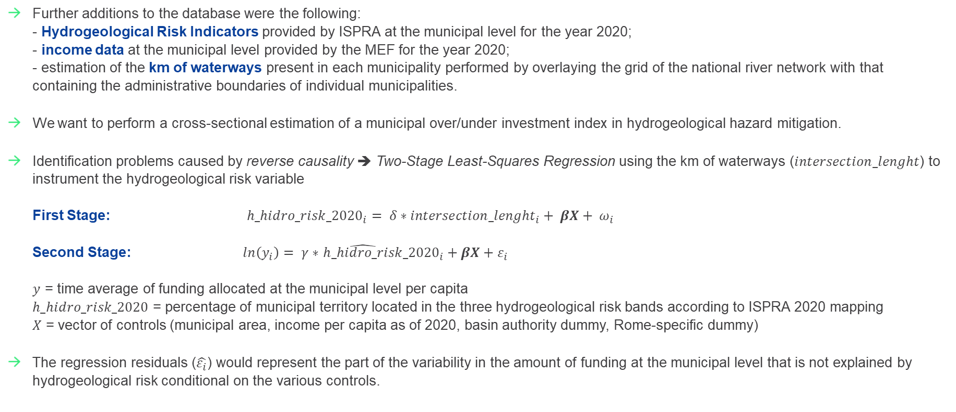
Investment Index construction
Further additions to the database were the following:
- Hydrogeological Risk Indicators provided by ISPRA at the municipal level for the year 2020;
- income data at the municipal level provided by the MEF for the year 2020;
- estimation of the km of waterways present in each municipality performed by overlaying the grid of the national river network with that containing the administrative boundaries of individual municipalities.
We want to perform a cross-sectional estimation of a municipal over/under investment index in hydrogeological hazard mitigation.
Identification problems caused by reverse causality ➔ Two-Stage Least-Squares Regression using the km of waterways ($intersection_lenght$) to instrument the hydrogeological risk variable
First Stage: ${h_hidro_risk_2020}_{i}= δ∗{intersection_lenght}_{i}+ βX+ ω_{i}$
Second Stage: $ln\left(y_{i}\right)= γ∗$ ${\hat{h_hidro_risk}_2020}_{i}+βX+ε_{i}$
$y$ = time average of funding allocated at the municipal level per capita
$h_hidro_risk_2020$ = percentage of municipal territory located in the three hydrogeological risk bands according to ISPRA 2020 mapping
$X$ = vector of controls (municipal area, income per capita as of 2020, basin authority dummy, Rome-specific dummy)
The regression residuals ($\hat{ε_{i}}$) would represent the part of the variability in the amount of funding at the municipal level that is not explained by hydrogeological risk conditional on the various controls.

Slide 6
Contributions to AMELIA and next steps
Main contributions of the Project to the AMELIA repository:
- database containing all the public work’s investments in hydrogeological risk mitigation (52.386 CUP of individual projects and 40 variables);
- index of relative over/under investment in hydrogeological risk mitigation at the municipal level.
Status of the project and next steps:
- database creation and harmonization (completed);
- improving the econometric specification by adding controls and employing new instruments (e.g., altitude of the municipality, river flow rate etc.) or a combination of them (work-in-progress);
- estimating the geolocation of all the investment projects (work-in-progress).

Slide 7
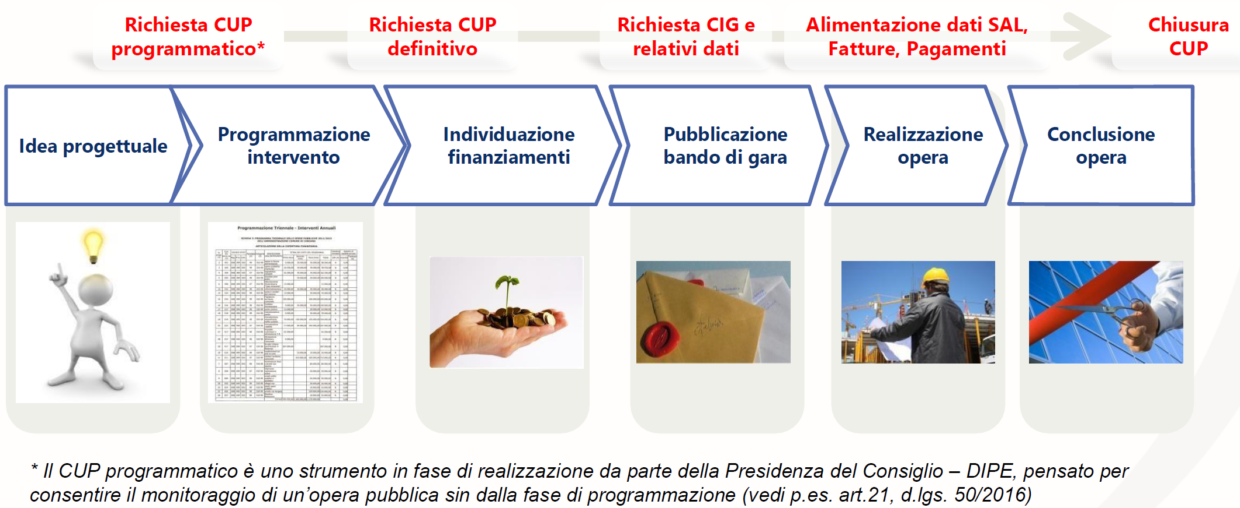
Appendix
Definition Public Works: Works referred to in Art. 3, c. 1, letter pp, legislative decree 50/2016, means: the result of a set of works, which in itself performs an economic or technical function. Works include both those that are the result of a set of construction or civil engineering works, and those of environmental defense and preservation, agronomic and forestry preservation, landscaping and natural engineering

Slide 8
Confidentiality
Any partial or total reproduction of its content is prohibited without written consent by Prometeia.
Copyright © 2023 Prometeia

Slide 9


Contacts
Bologna
Piazza Trento e Trieste, 3
+39 051 6480911
info@prometeia.com
Milan
Via Brera, 18
Viale Monza, 259
+39 02 80505845
info@prometeia.com
Rome
Viale Regina Margherita, 279
info@prometeia.com
London
Dashwood House, 69 Old Broad Street
EC2M 1QS
+44 (0) 207 786 3525
uk@prometeia.com
Istanbul
River Plaza, Kat 19
Büyükdere Caddesi Bahar Sokak
No. 13, 34394
| Levent | Istanbul | Turkey
+ 90 212 709 02 80 – 81 – 82
turkey@prometeia.com
Zurich
Technoparkstrasse, 1 – 8005
switzerland@prometeia.com
Prometeia
Cairo
Smart Village - Concordia Building, B2111
Km 28 Cairo Alex Desert Road
6 of October City, Giza
info@prometeia.com
Vienna
Wiedner Gürtel,13 – 1100
info@prometeia.com
Prometeiagroup
Prometeia
www.prometeia.com

