Slide 1
Missione 4 Istruzione e Ricerca
Climate change and house prices: can extreme weather events endanger
household wealth?

Slide 2
Research group
UNIBG Team
Piera Bello
Annalisa Cristini
Maria Cristina Barbieri Goes
Federica Origo
In touch with Prometeia and ANIA for collaborations

Slide 3
Motivation and relevance for the Financial Resilience work package
Housing and land are the main assets of Italian households
Their value is 5294 bil, or 4.6 times household disposable income, or more than 3 times GDP (2017) (Cannari et al., 2016; Caprara et al., 2018; De Bonis et al., 2020)
Household wealth is strongly correlated with housing prices. Note: the rise in house prices between 1950 and 2012 is for ⅔ due to the increase in the price of land (Cannari et al., 2016)
80% of households are homeowners (Eu-silc 2022)
93% for couples 65+ no kids – 67% for single less 65
88% in villages up to 2000 inhabitants – 75% metropolitan areas centre or 50000+ inhabitants
Consider the risk of extreme weather-related events
Italy accounts for 2 / 3 of landslides registered in Europe
1/ 4 of the housing stock in Italy is exposed to the risk of floods
The estimated annual loss to the value of the housing stock can be up to 3 bil euros (Loberto and Spuri, 2023) or 0.15% of GDP, due to flood risk
Missione 4 • Istruzione e Ricerca
Missione 4 • Istruzione e Ricerca

Slide 4
Objectives and research questions
Broaden the weather-related risk knowledge with socio-economic indicators of the areas involved at the municipal level (Descriptive analysis, maps)
Weather-related risks: landslides, floods, coastal erosion, high temperatures
Possible indicators: income/wealth, inequality measures, hh composition, age, migration, education level of population, ..→ contribution to platform AMELIA
Explore the impact of extreme weather events on house prices/rents and the role of policies (Causal analysis)
Do extreme weather events cause changes in house prices/rents?
Are the risks of extreme weather transferred to house prices/rents?
How is household real wealth affected?
Does citizens’ awareness of climate change risks mediate the transfer of risk on house prices/rents?
Do land-use policies correlate with these risks?

Slide 5
Literature Review
Impact of Extreme Events - Acute Hazards - on the Economy and Real Estate:
Evidence that large flood events significantly reduce property prices for flood-affected properties (Atreya et al.;2015).
The drop in prices may be substantial initially but diminishes over time (Beltran et al., 2019 – UK inundation). Likewise, for NYC housing prices after Hurricane Sandy (Cohen, 2021)
Effect of heat waves on the Real Estate Market:
During warmer months, housing demand falls in Italy, leading to reduced house prices, especially for properties lacking resilience to heat (Cascarano, 2023).
Exposure to local heat shocks in the continental United States leads to an elevated belief in climate change and results in a significant decrease in house prices, particularly in communities concerned about global warming and among counties heavily exposed to sea level rise risks (Ma and Yildirim, 2023).
Impact of Temperature Rises on Economic Activity - Chronic Hazards:

Slide 6
Literature Review
Estimated real estate loss due to floods
Loberto and Spuri (2023): Use ISPRA flooding risk tiling, OMI average house price in the area and number of houses from Census to estimate the value of dwellings potentially exposed to flooding. This is close to 1,000 bil euros.
If the expected percentage loss is <60% of the original value, considering only the base floor apartments, the annual expected loss is around 3 billion euros.
Gourevitch et al. (2023) increasing costs of flooding are not fully captured in property values. They estimate residential properties exposed to food risk are overvalued by US$121–US$237 billion. Related financial risks are mostly borne by: low-income households (prob of losing home equity from price deflation) and municipalities heavily reliant on property taxes for revenue (vulnerable to budgetary shortfalls). The consequences of these financial risks will depend on policy choices that influence who bears the costs of climate change.
Climate change awareness
Osberghaus and Fugger (2022): Use a panel survey covering 22,251 observations from 11,194 geo-located households collected in Germany between 2012 and 2015, combined with satellite imagery of a major flood event in 2013. Flood experience had a significant positive effect on the beliefs in the existence of climate change for those respondents living close to the flooded area. However, the effect decreases sharply with distance.

Slide 7
Data: Four main datasets
ISPRA: hydrogeological risks, extreme weather events, damages. Municipality and sub-m level
OMI: house and rent prices, n. of transactions, by different types of houses. M and sub-m. zones- OMI zones, semester-year
Agency Revenue: income from tax declarations. Zip-code, year
Census: nr. of houses, types of families; municipality level, year
Initial task: integrate the data into a consistent database

Slide 8
ISPRA datasets
Detailed reports/accounting of extreme events (date, location, description, damages,...) - Inventory of landslides in Italy (IFFI). 2018-2019-2020
Landslides: number of events and description
Floods: number of events and description
Risk levels tiling maps. Available for 2017 and 2020-21 (next in 2025)
Landslide risk areas (frequency and magnitude of events)
Danger: very high P4, high P3, medium P2, moderate P1 and attention areas AA,
Flood risk areas (return period)
High Probability Hazard: return period 20-50 yrs (HPH); Medium Probability Hazard: return period 100-200 yrs (MPH); Low Probability Hazard: return period >200 yrs (LPH).
Report on hydrogeological instability: danger from landslides, floods, coastal erosion, and relative risk indicators for Italy.

Slide 9
ISPRA: extracting municipality-level data
Landslide data contain municipality-level information (date, municipality, description, death toll, damages)
Flood data provides data on basin areas hit by the event highlighting provinces and regions affected.; in addition info on the death toll, estimated damage
In order to obtain municipality information, we use the description reported in main effects on the ground (“principali effetti al suolo”) and extract the municipalities/sub-municipalities mentioned in the text (Example next slide)

Slide 10
ISPRA Extracting the municipality info from flood accounting
Example: “L’evento temporalesco, a carattere marcatamente impulsivo, si è verificato nella serata di sabato 1 settembre ed ha interessato la zona di Verona, innescando un’alluvione lampo per l’esondazione del torrente Progno che ha allagato molte zone della città. Le situazioni più critiche si sono avute tra Pedemonte e Santa Maria di Negrar, dove sono caduti fino a 170 mm di pioggia e sono stati sommersi diversi box al cui interno erano parcheggiate alcune auto. Allagate anche diverse zone di Parona, anche qui con auto sommerse dall’acqua. Esondazioni più localizzate e di minore intensità si sono verificate per la piena di corsi d’acqua del reticolo minore nella zona di Negrar, in bassa Valpolicella, a Zevio, a Soave e nell’est veronese in genere. Tra il comune di Soave e Cazzano di Tramigna parte di una collina è franata. Le precipitazioni, inoltre, hanno provocato la caduta di massi sulle strade in alta Valle del Chiampo (soprattutto a Crespadoro) e sui colli Berici. Frane si sono verificate anche nella zona di Monteforte d’Alpone lungo il versante del monte Foscarino, in località Coste, mobilitando diversi metri cubi di terra che sono confluiti in un fosso che raccoglie l’acqua del versante e la convoglia al Rio delle Carbonare che, di conseguenza, è esondato invadendo strade, cantine e magazzini.”
1. Verona; 2. Pedemonte; 3. Negrar; 4. Parona; 5. Zevio; 6. Soave; 7. Cazzano di Tramigna; 8. Crespadoro; 9. Monteforte d’Alpone
Missione 4 • Istruzione e Ricerca
Missione 4 • Istruzione e Ricerca

Slide 11
OMI – House prices and rents (Agenzia Entrate - OMI)
OMI: Released every semester (2006, 1st Semester - 2022, 2nd Semester). It contains information on min and maximum market values and rent prices (per square meter) of dwellings, taking into account location (zone OMI* - more than 28,000 in Italy), building type**, and conservation status***.
* Zone OMI: an area within the territory of a municipality homogeneous in terms of economic and socio-environmental conditions, in which the values of real estate units are sufficiently similar
** Building type: Abitazioni civili (Civil dwellings); Abitazioni di tipo economico (Affordable housing); Abitazioni signorile (Luxury houses); Abitazioni tipiche dei luoghi (Typical or traditional dwellings); Ville e villini (Villas and cottages)
*** Conservation status: Normale (normal), Ottimo (excellent), Scadente (poor)
Missione 4 • Istruzione e Ricerca
Missione 4 • Istruzione e Ricerca

Slide 12
OMI – Types of buildings considered
Abitazioni civili – Civil dwellings Abitazioni di tipo economico – Affordable housing Abitazioni signorile – Abitazioni tipiche dei luoghi – Typical or traditional dwellings Autorimesse – Garages Box – Box Capannoni industriali – Industrial sheds Capannoni tipici – Typical sheds Centri commerciali – Shopping malls Laboratori – Laboratories Magazzini – Warehouses Negozi – Stores Pensioni e assimilati – Posti auto coperti – Covered parking spaces Posto auto scoperti – Uncovered parking spaces Uffici – Offices Uffici strutturati – Structured offices Ville e villini – Villas and cottages
Missione 4 • Istruzione e Ricerca
Missione 4 • Istruzione e Ricerca

Slide 13
Merge ISPRA landslides and floods data with OMI
Associate the day on which the landslide occurred with the corresponding semester-year.
Split the “period of the event” of floods into «date event started» and «date event finished»
Associate the day on which the flood started with the corresponding semester-year.
Merge the dataset on landslides and floods with OMI house prices

Slide 14
Merge ISPRA landslides and floods data with OMI
Limitations of OMI data
OMI zones may not be sufficiently fine to distinguish between areas affected/not affected by the event.
Likewise, the same OMI zone may overlap with different risk-level tiling
OMI data → average price levels may confound several effects (nr. of buildings fit for residential use may change due to the event; after the event renovations may lead to higher quality buildings- partially controllable through ‘building condition’, available in OMI and measure of damages from ISPRA
We are in touch with Immobiliare.it to consider their dataset

Slide 15
Methods
Descriptive analysis: merge the datasets at the municipality level and year-semester
Causal analysis: exploit the occurrence date and changes in risk areas. Use DiD, Synthetic Control Methods

Slide 16
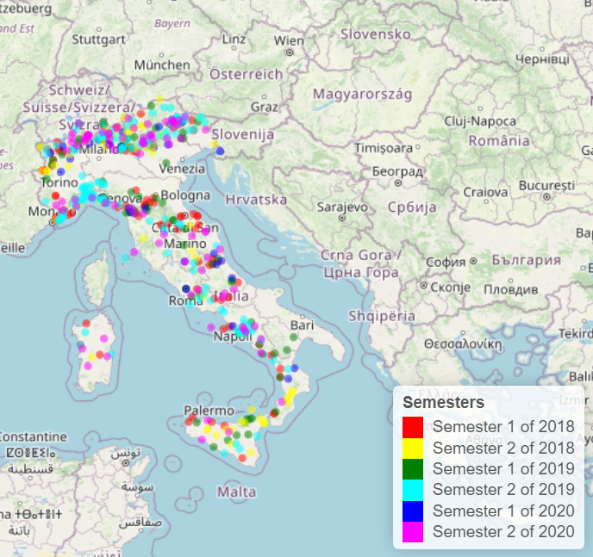
Number of floods by semester
Number of landslides by semester
Source: ISPRA environmental data yearbook - data on landslides/floods, authors’ elaboration
Missione 4 • Istruzione e Ricerca
Missione 4 • Istruzione e Ricerca

Slide 17
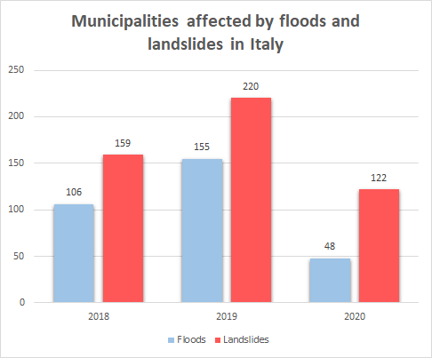
Source: ISPRA environmental data yearbook - data on floods and landslides, authors’ elaboration
Missione 4 • Istruzione e Ricerca
Missione 4 • Istruzione e Ricerca

Slide 18
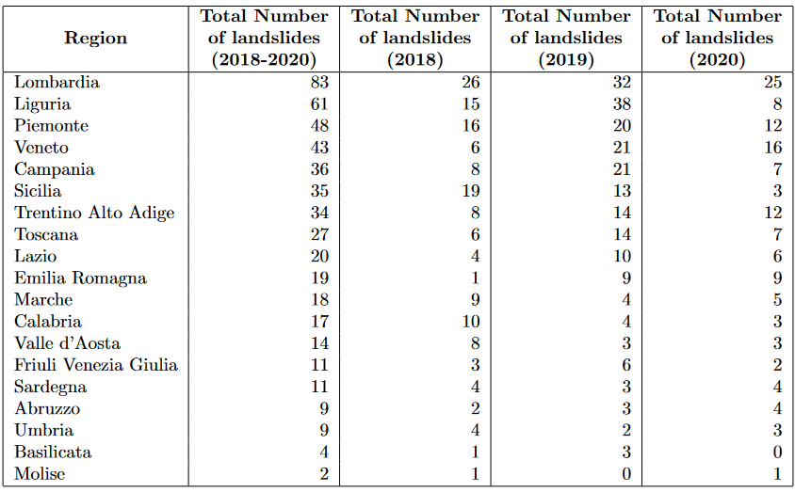
Number of landslides by region (2018-2020)
Source: ISPRA environmental data yearbook - data on landslides, authors’ elaboration
Missione 4 • Istruzione e Ricerca
Missione 4 • Istruzione e Ricerca

Slide 19
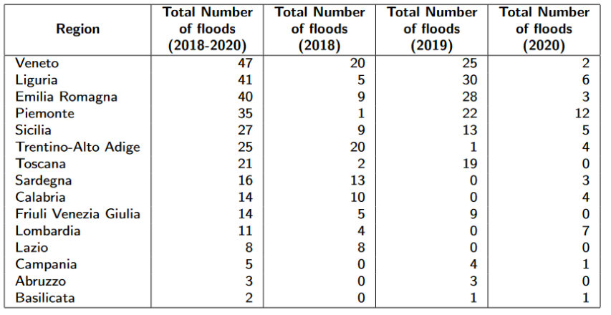
Number of floods by region (2018-2020)
Source: ISPRA environmental data yearbook - data on floods, authors’ elaboration
Missione 4 • Istruzione e Ricerca
Missione 4 • Istruzione e Ricerca

Slide 20
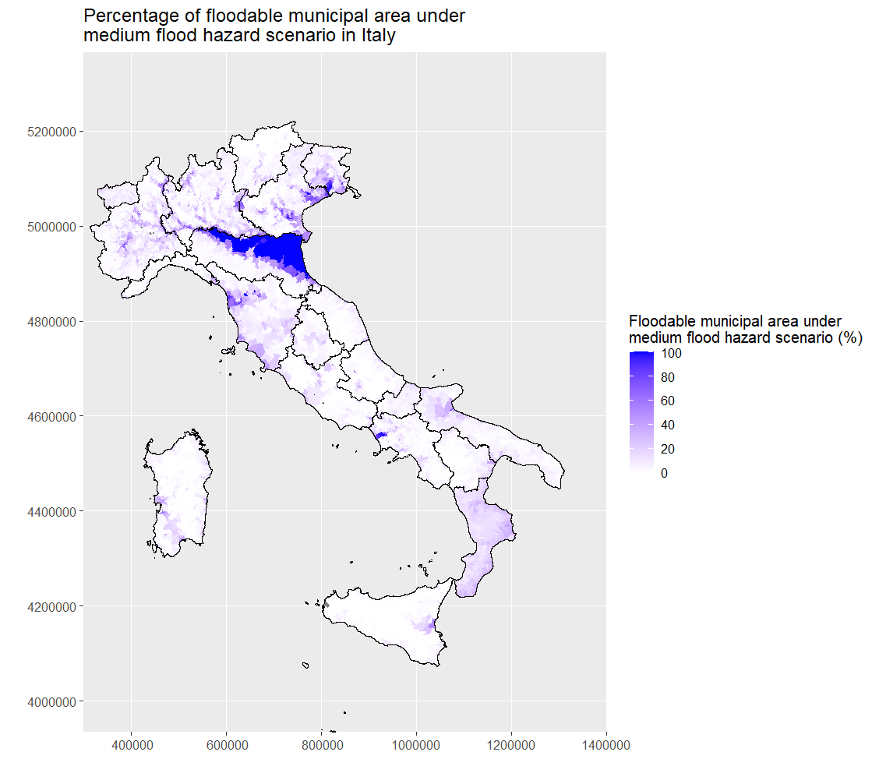
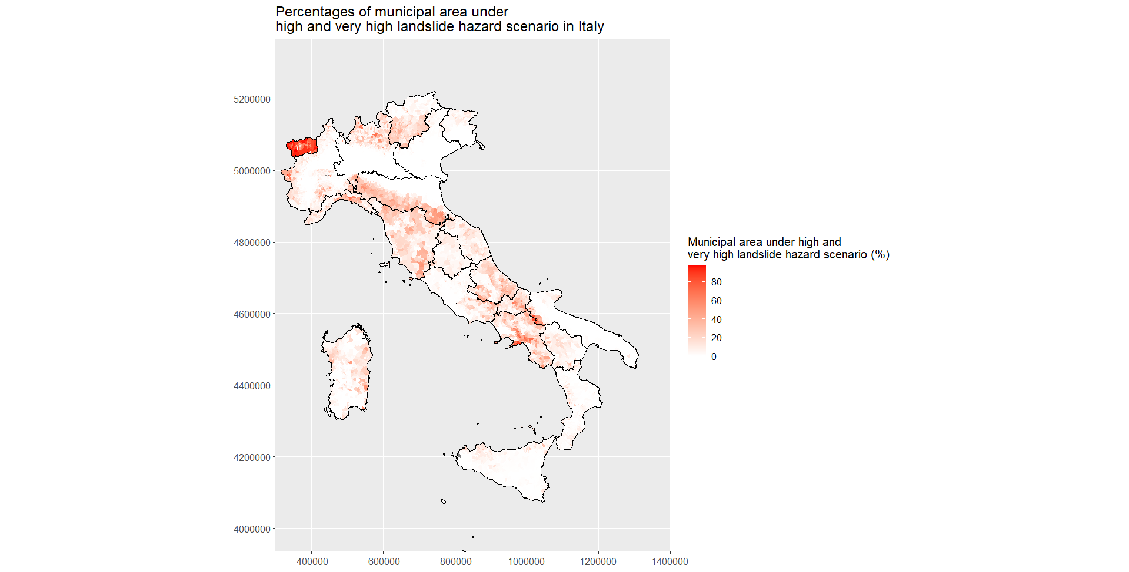
Floodable municipal areas medium risk (%)
Very high and high landslide-risk municipal areas (%)
Source: Mosaicatura ISPRA 2020, authors’ elaboration
IdroGEO Platform: assessing landslide and flood hazards (https://idrogeo.isprambiente.it/app/pir)
Missione 4 • Istruzione e Ricerca
Missione 4 • Istruzione e Ricerca

Slide 21
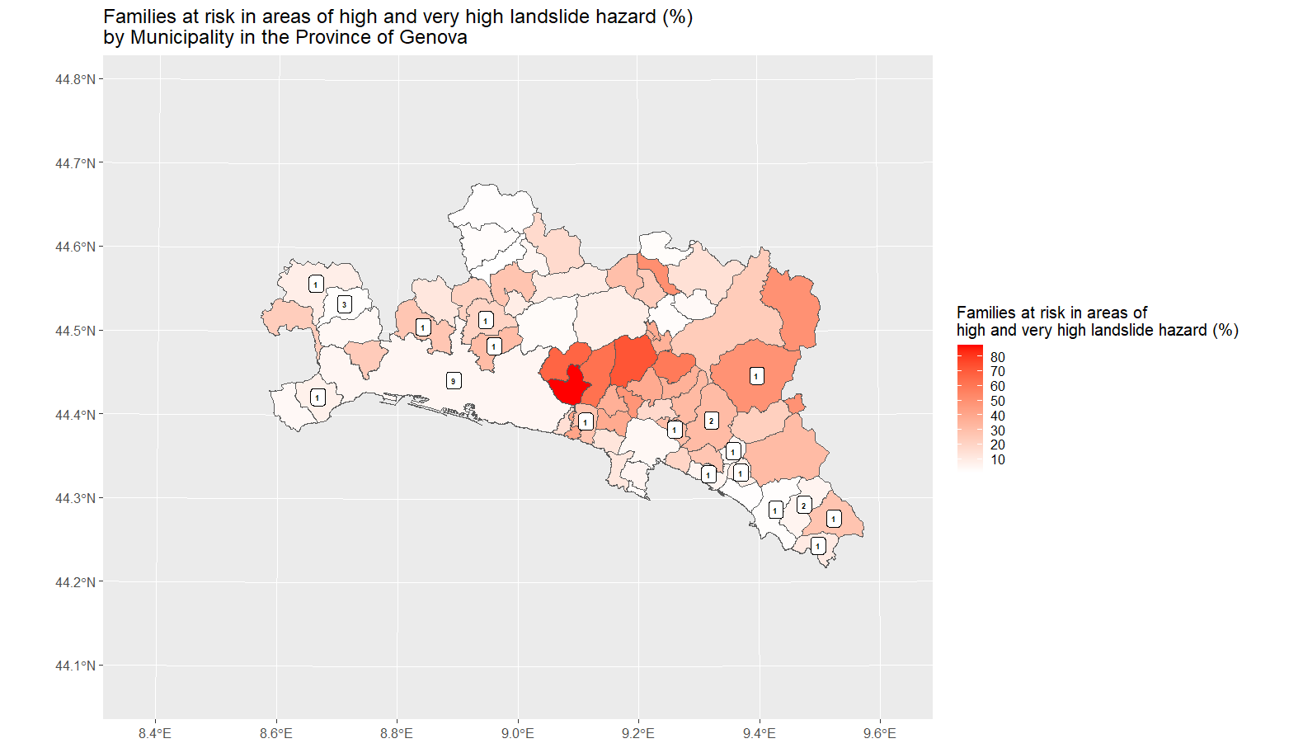
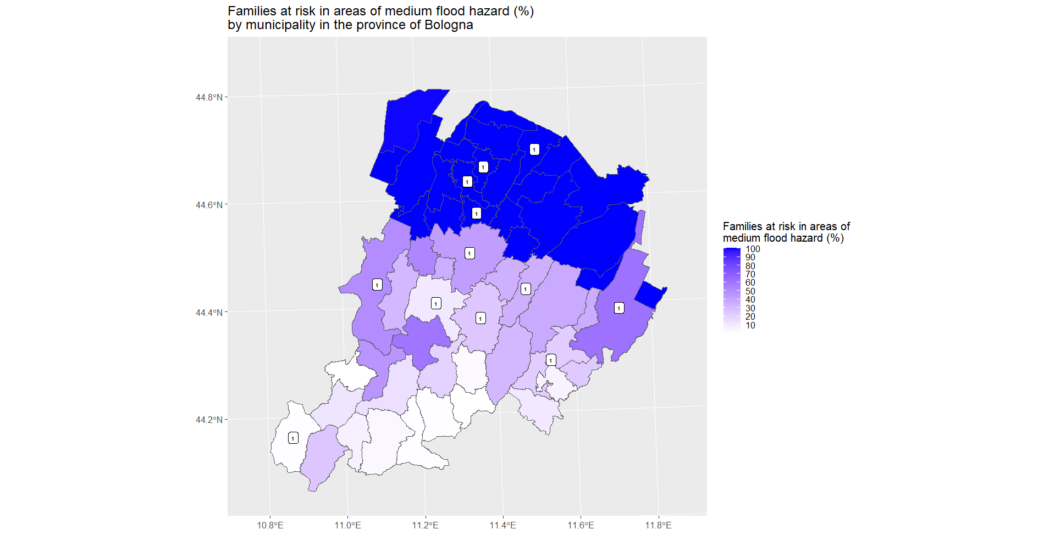
Families at risk in areas of high and v. high landslide risk (%) by municipality (Province GE)
Families at risk in areas of medium flood hazard (%) by municipality (Province BO)
Source: Mosaicatura ISPRA 2020; ISPRA environmental data yearbook data on landslides, authors’ elaboration. *Numbers in the map represent the number of landslides that occurred in the municipality between 2018-2020
Source: Mosaicatura ISPRA 2020; ISPRA environmental data yearbook data on floods, authors’ elaboration. *Numbers in the map represent the number of floods that occurred in the municipality between 2018-2020
Missione 4 • Istruzione e Ricerca
Missione 4 • Istruzione e Ricerca

Slide 22
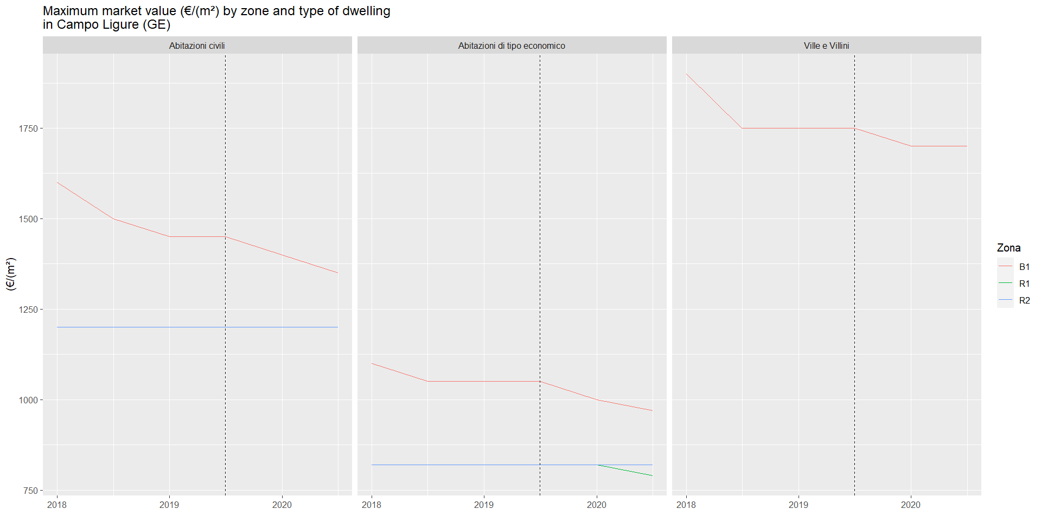
Maximum market value (€/m2) by zone and type of dwelling in Campo Ligure
Source: Agenzia Entrate - OMI and ISPRA environmental data yearbook data on floods, authors’ elaboration.

Slide 23
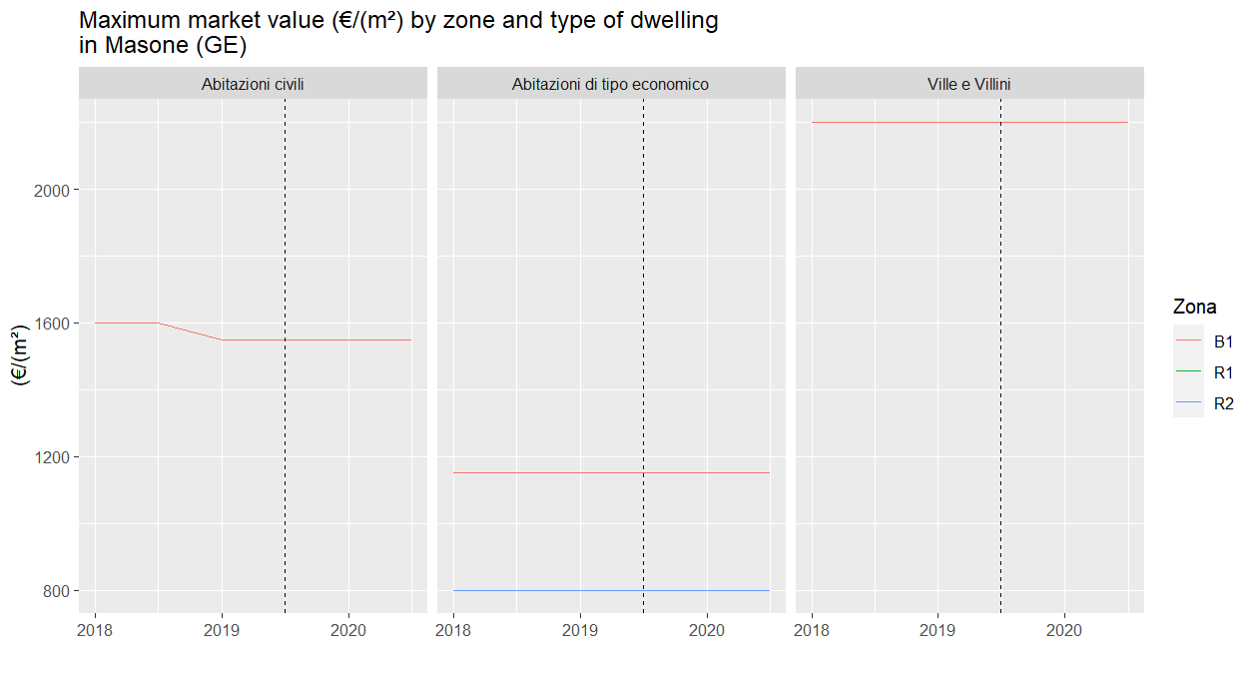
Maximum market value (€/m2) by zone and type of dwelling in Masone (GE) Similar Risk, no event, bordering with Campo Ligure
Source: Agenzia Entrate - OMI and ISPRA environmental data yearbook data on floods, authors’ elaboration.

Slide 24
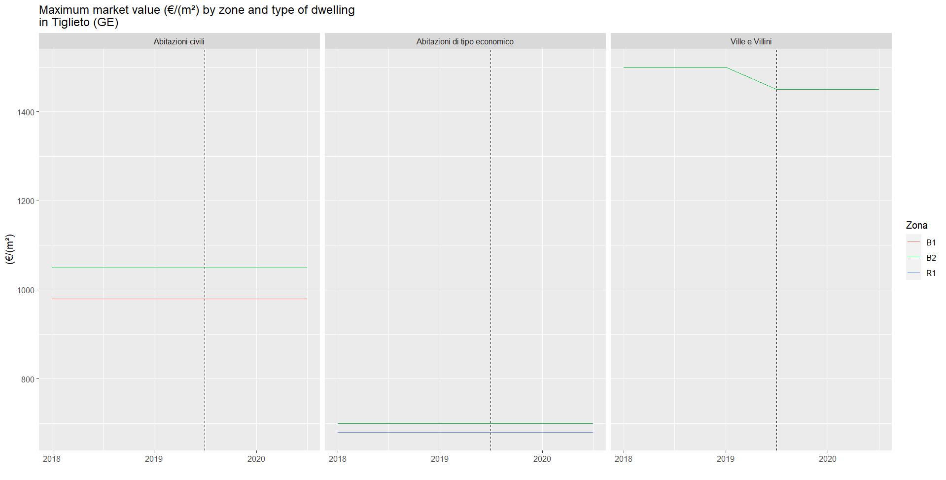
Maximum market value (€/m2) by zone and type of dwelling in Tiglieto (GE) Higher Risk, no event, bordering with Campo Ligure
Source: Agenzia Entrate - OMI and ISPRA environmental data yearbook data on floods, authors’ elaboration.

Slide 25
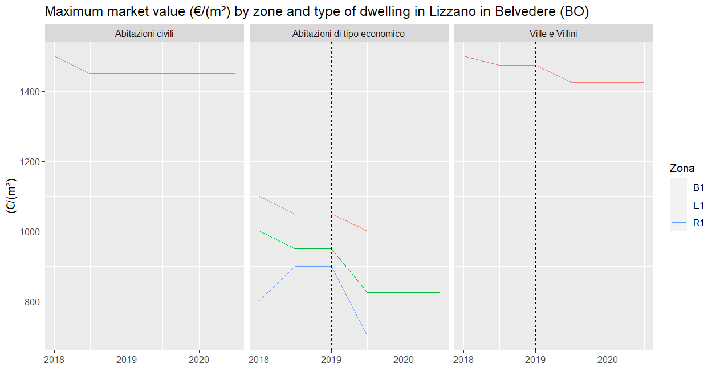
Maximum market value (€/m2) by zone and type of dwelling in Lizzano in Belvedere
Source: Agenzia Entrate - OMI and ISPRA environmental data yearbook data on floods, authors’ elaboration.

Slide 26
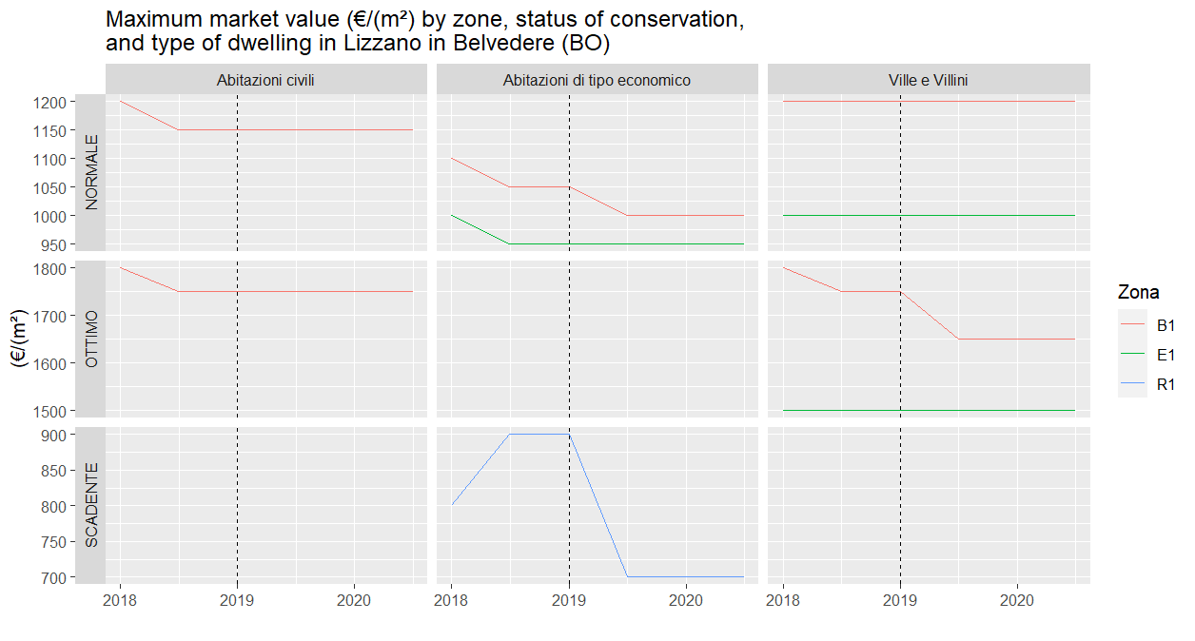
Maximum market value (€/m2) by zone, conservation status, and type of dwelling in Lizzano in Belvedere
Source: Agenzia Entrate - OMI and ISPRA environmental data yearbook data on floods, authors’ elaboration.

Slide 27
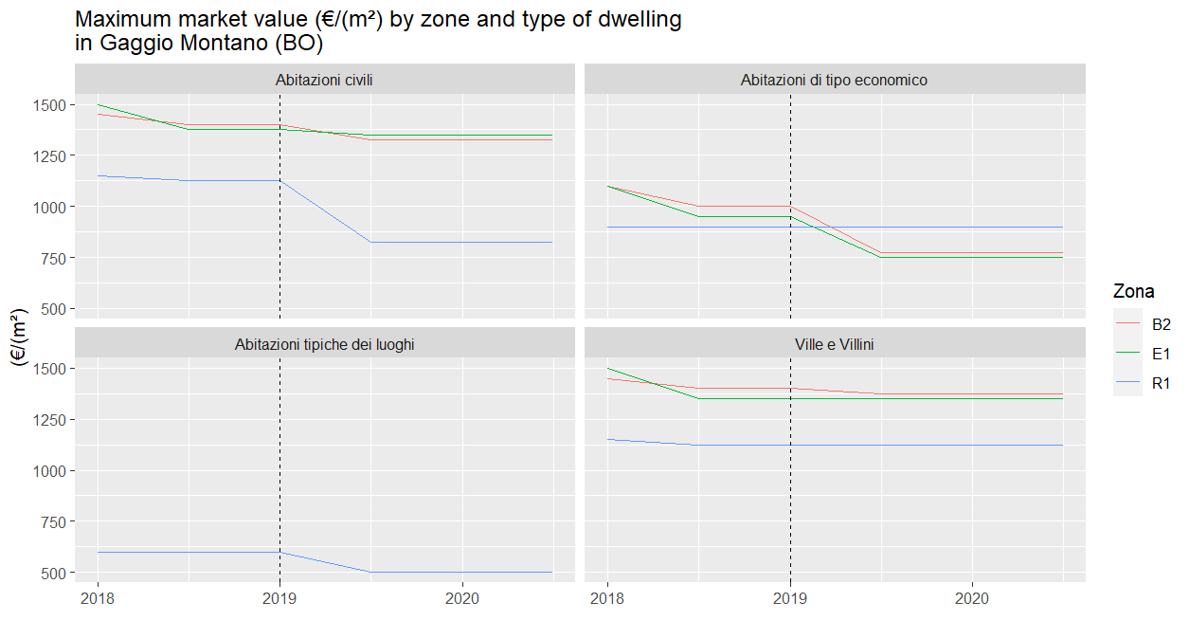
Maximum market value (€/m2) by zone and type of dwelling in Gaggio Montano (BO) Similar Risk, no event, bordering with Lizzano in Belvedere
Source: Agenzia Entrate - OMI and ISPRA environmental data yearbook data on floods, authors’ elaboration.

Slide 28
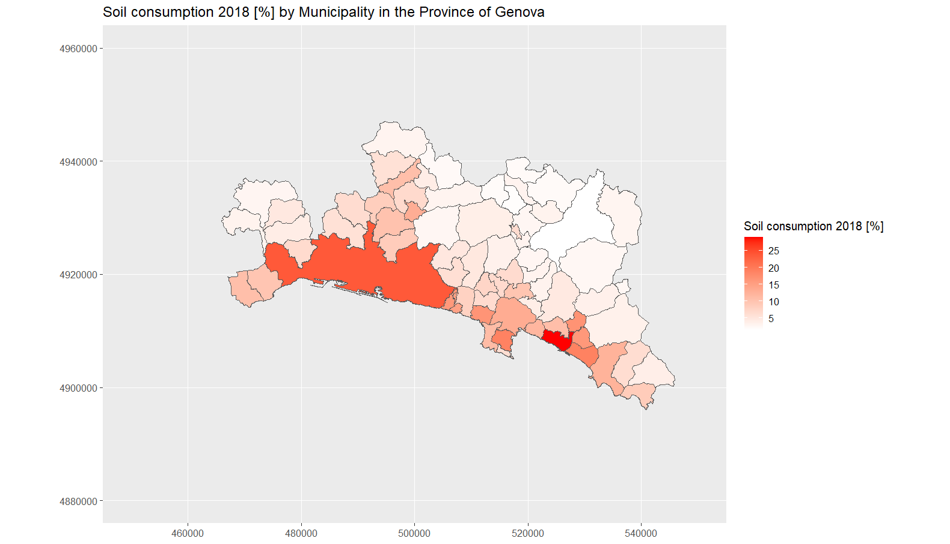
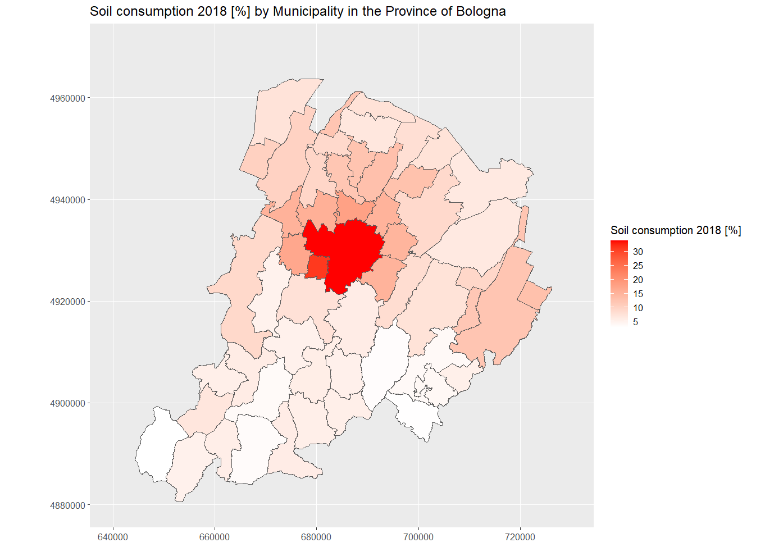
Data – Soil Consumption (ISPRA)
Soil consumption 2018 (%) by municipality in the Province of Genova Source: ISPRA Data, authors’ elaboration
Soil consumption 2018 (%) by municipality in the Province of Bologna Source: ISPRA Data, authors’ elaboration
Missione 4 • Istruzione e Ricerca
Missione 4 • Istruzione e Ricerca

Slide 29
Next steps
The frequency and severity of extreme-weather-related events is expected to increase with climate change
Knowledge about hydrogeological instability is largely unexploited with regard to its economic and socio-economic effects
The project intends to make use of extreme-weather-related events for causal inference on economic and socioeconomic dimensions and as additional information to contribute to AMELIA platform

Slide 30
References
Acevedo, S., Mrkaic, M., Novta, N., Pugacheva, E., and Topalova, P. (2020). The effects of weather shocks on economic activity: what are the channels of impact? Journal of Macroeconomics, 65:103207.
Alpino, M., Citino, L., de Blasio, G., and Zeni, F. (2022). Gli effetti del cambiamento climatico sull’economia italiana (the effects of climate change on the italian economy). Bank of Italy Occasional Paper, (728).
Atreya, A. and Ferreira, S. (2015). Seeing is believing? evidence from property prices in inundated areas. Risk Analysis, 35(5):828–848.
Beltran, A., Maddison, D., and Elliott, R. (2019). The impact of flooding on property prices: A repeat-sales approach. Journal of Environmental Economics and Management, 95:62–86.
Bin, O. and Landry, C. E. (2013). Changes in implicit flood risk premiums: Empirical evidence from the housing market. Journal of Environmental Economics and management, 65(3):361–376.
Brunetti, M., Croce, P., Gomellini, M., and Piselli, P. (2023). Dinamica delle temperature e attivit`a economica in Italia: un’analisi di lungo periodo. Technical Report Numero 787 – Luglio 2023, Questioni di Economia e Finanza (Occasional Papers).
Bunten, D. M. and Kahn, M. E. (2014). The impact of emerging climate risks on urban real estate price dynamics. Technical report, National Bureau of Economic Research.
Cannari, L., G. D'Alessio, and G. Vecchi. (2016). I prezzi delle abitazioni in Italia, 1927-2012. Banca d’Italia. Questioni di Economia e Finanza n. 333
Caprara, D., R. De Bonis, and L. Infante. (2018). La ricchezza delle famiglie in sintesi: l'Italia e il confronto internazionale.Banca d’Italia. Questioni di Economia e Finanza n. 470

Slide 31
References
Cascarano, M. and Natoli, F. (2023). Temperatures and search: evidence from the housing market. Available at SSRN 4362881.
Cohen, J. P., Barr, J., and Kim, E. (2021). Storm surges, informational shocks, and the price of urban real estate: An application to the case of hurricane Sandy. Regional Science and Urban Economics, 90:103694.
Colacito, R., Hoffmann, B., and Phan, T. (2019). Temperature and growth: A panel analysis of the united states. Journal of Money, Credit and Banking, 51(2-3):313–368.
De Bonis R., Liberati D., Muellbauer J. and Rondinelli C. (2020). Consumption and Wealth: New Evidence from Italy. Bank of Italy WP. 1304.
Galinato, G. I. and Tantihkarnchana, P. (2018). The amenity value of climate change across different regions in the united states. Applied Economics, 50(37):4024–4039.
Garbarino, N. and Guin, B. (2021). High water, no marks? biased lending after extreme weather. Journal of Financial Stability, 54:100874.
Gourevitch, J.D., Kousky, C., Liao, Y. et al. (2023). Unpriced climate risk and the potential consequences of overvaluation in US housing markets. Nature. Clim. Change 13, 250–257.
Kahn, M. E. (2009). Urban growth and climate change. Annu. Rev. Resour. Econ., 1(1):333–350.
Loberto, M., and Spuri, M. (2023). L’impatto del rischio di alluvione sulla ricchezza immobiliare in Italia (The impact of flood risk on real estate wealth in Italy). Bank of Italy Occasional Paper, (768).

Slide 32
References
Ma, L., and Yildirim, Y. (2023). High Temperature, Climate Change and Real Estate Prices, Working paper .
Osberghaus and Fugger (2022). Natural disasters and climate change beliefs: The role of distance and prior beliefs. Global Environmental Change. Volume 74
Spencer, N. (2023). Extreme weather and real estate: A case study of the jamaican housing, Working paper .
Trigila A., Iadanza C., Lastoria B., Bussettini M., Barbano A. (2021) Dissesto idrogeologico in Italia: pericolosità e indicatori di rischio - Edizione 2021. ISPRA, Rapporti 356/2021

