Slide 1
Missione 4 Istruzione e Ricerca
Small area measures of vulnerability and sustainability
Jonathan Pratschke
Enrica Morlicchio
University of Naples

Slide 2
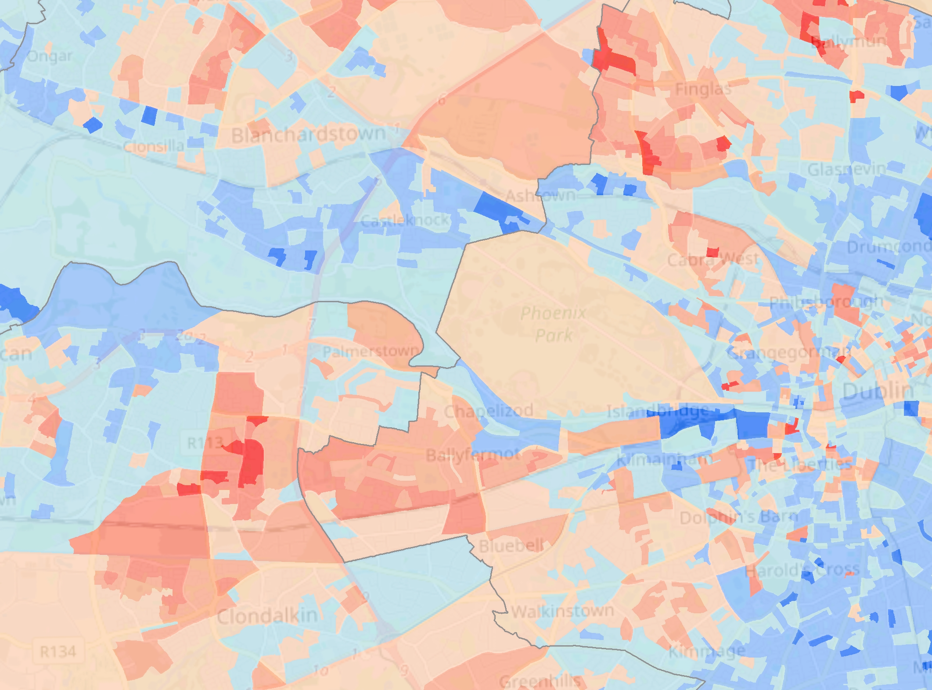
Summary
Small area measures
Data sources
Appropriate geographies
Measures and indices
Small area measures of vulnerability and sustainability
Missione 4 • Istruzione e Ricerca

Slide 3
1. Small area measures
Small areas - “subnational units for which area-specific samples from national surveys are too small to provide reliable estimates”
Uniform coverage of national territory with a hierarchy of units
A useful analytical frame – all data can be integrated and linked
A powerful communication tool – e.g. interactive maps
A crucial component of the national data infrastructure
Small area measures as a proxy for individual characteristics
Small area measures of vulnerability and sustainability
Missione 4 • Istruzione e Ricerca

Slide 4
2. Data sources
Small area data generally come from a census or are based on registry data for the entire population
In Italy there is a sample-based census and administrative databases are increasingly used to estimate spatial indicators
Good coverage of demographic characteristics (citizenship, age structure, household composition, marital status)
Reasonable coverage of socio-economic position - labour market situation, social class and education
Small area measures of vulnerability and sustainability
Missione 4 • Istruzione e Ricerca

Slide 5
4. Appropriate geographies
The smallest spatial units are the census enumeration areas (410,441 areas, half with less than 50 residents)
There is a big jump from these areas to sub-municipal quarters etc.
ISTAT has never released intermediate “output areas”
This was the first step in this project, completed using algorithmic rezoning (yielding 35,925 areas)
The output areas have a mean population of 1,600
Can be used to compare 2011 census and census-like data for 2021
Small area measures of vulnerability and sustainability
Missione 4 • Istruzione e Ricerca

Slide 6
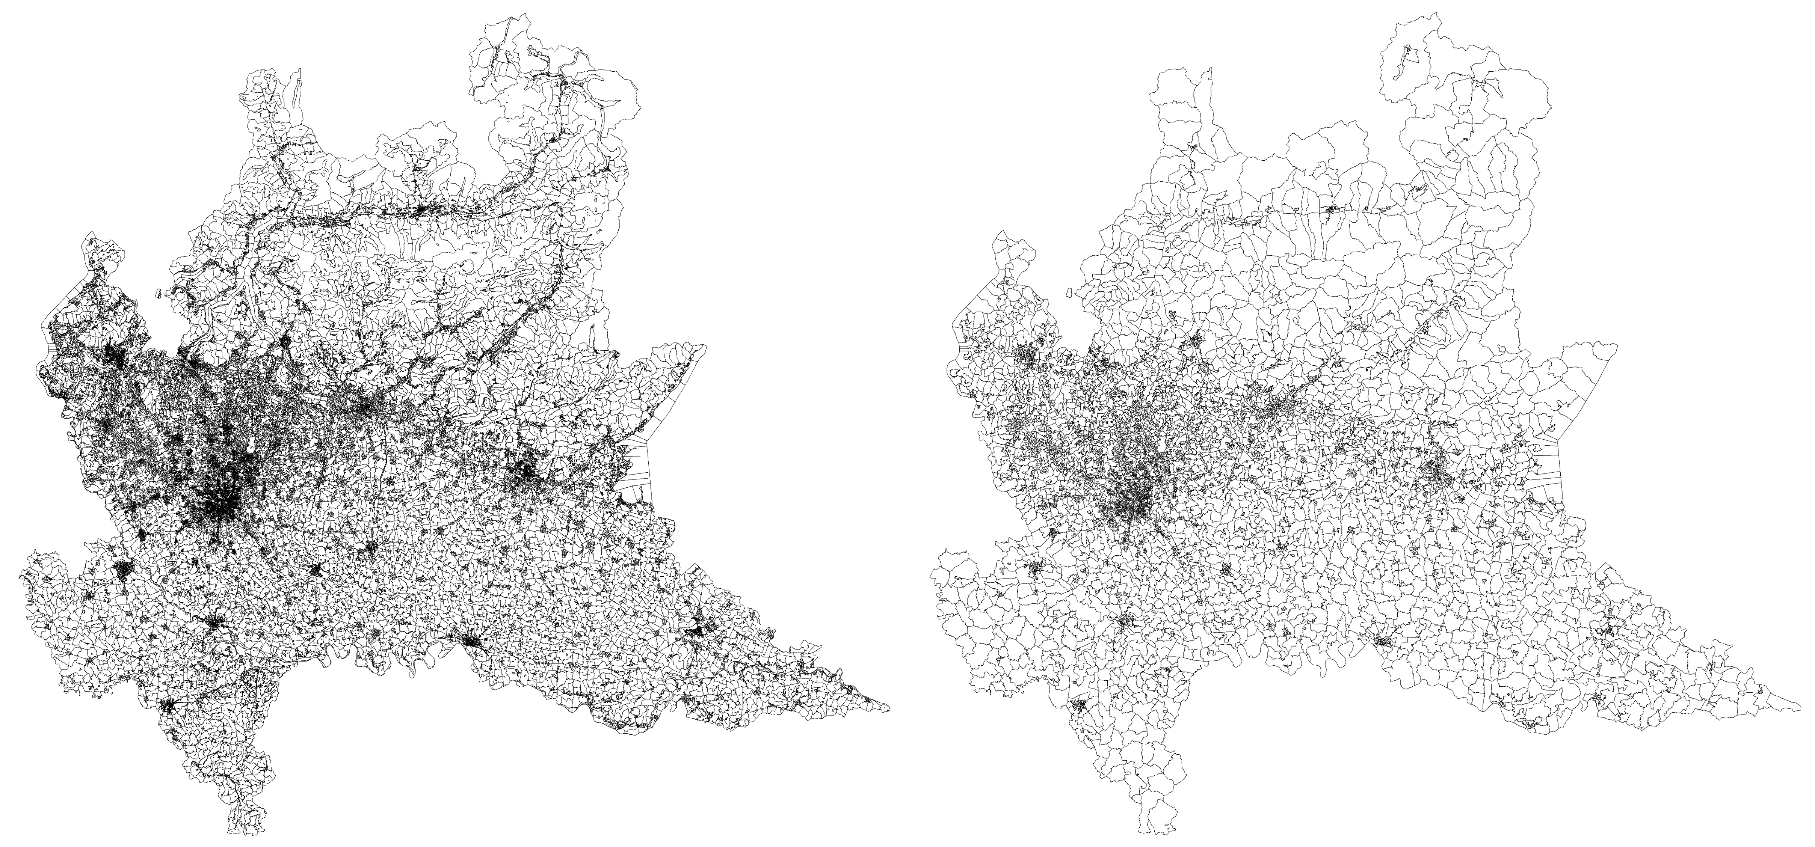
Enumeration areas (left) and new output areas (right)
Small area measures of vulnerability and sustainability
Missione 4 • Istruzione e Ricerca

Slide 7
5. Measures and indices
From the perspective of sustainbility, we need indices of:
socio-economic composition (education, housing, occupation)
demographic vitality (age structure, population change)
labour market situation (unemployment, participation)
ethnic composition (by region of origin, 1st/2nd generation)
household structure (lone parents, one-person households)
overall affluence/deprivation
Small area measures of vulnerability and sustainability
Missione 4 • Istruzione e Ricerca

